Slide 1
JP Morgan Code for Good 2017: Ocean’s Daughter Conservation Alliance
GROUP 8: Junior Recinos, Sanjeeth Bhat, Rachel Klesius, David Sherrier, Rahul Kant, Sreejhit Chidarala

Slide 2
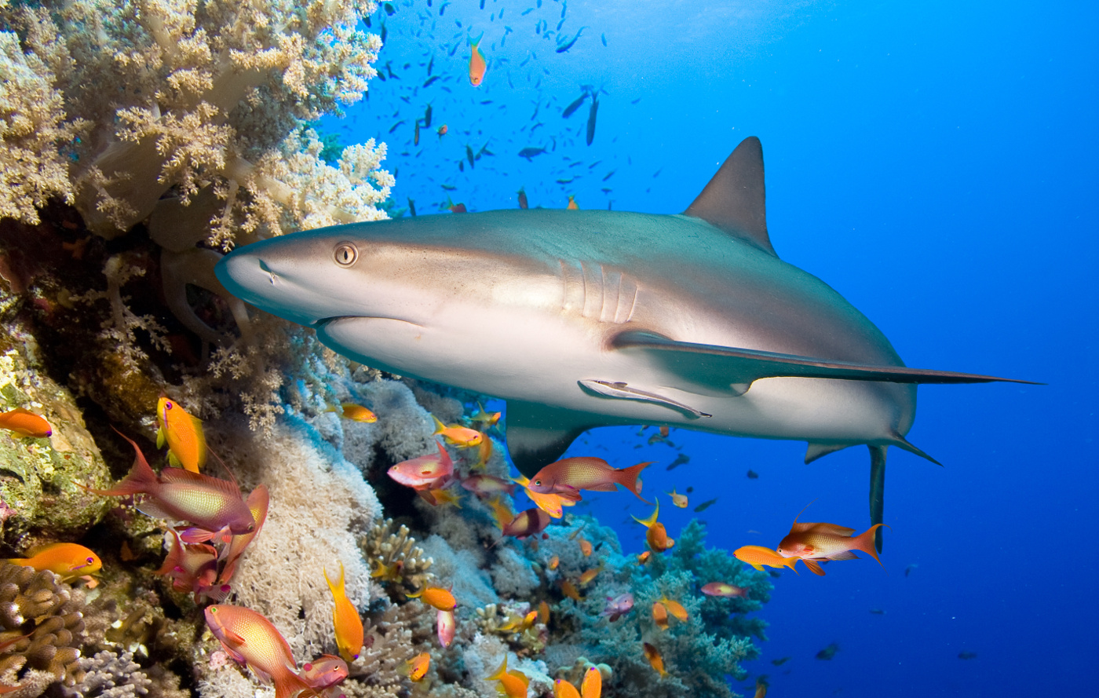
Background
“An estimated 50-80% of all life on earth is found under the ocean surface and the oceans contain 99% of the living space on the planet.” (National Geographic)

Slide 3
The Objective
To engage and motivate children (grades k-12) to become aware of the detrimental human impacts on the marine environment so they can learn to keep the world a better place.

Slide 4
Solution to the challenge
To develop an application on the mobile platform to educate and encourage children( k-12 )to take initiative towards protecting the marine life ecosystem from pollution through positive reinforcement.

Slide 5
Our Solution to the challenge
An android based game
FinFun
Background, Rules, Features and Modifications

Slide 6
Teamwork
Rahul:
David:
Sanjeeth: Worked on application screen navigation code and the app’s reward system for the user
Sreejhit: Worked on screen navigation, visual display organization, UI/UX, and presentation.
Junior:
Rachel: Created game figures using Adobe Photoshop

Slide 7
Technical Architecture
Software: Android Studio, Adobe Photoshop,
Languages: Java, XML
Tools: GitHub, Bash Scripting, FireBase

Slide 8
Practicality and sustainability
Moving forward, the solution to the challenge is scalable in terms of the complexity of the software and game difficulty so therefore it is bound to improve.
Different levels through various characters
Location-specific Augmented Reality through Unity 3D & C#

Slide 9
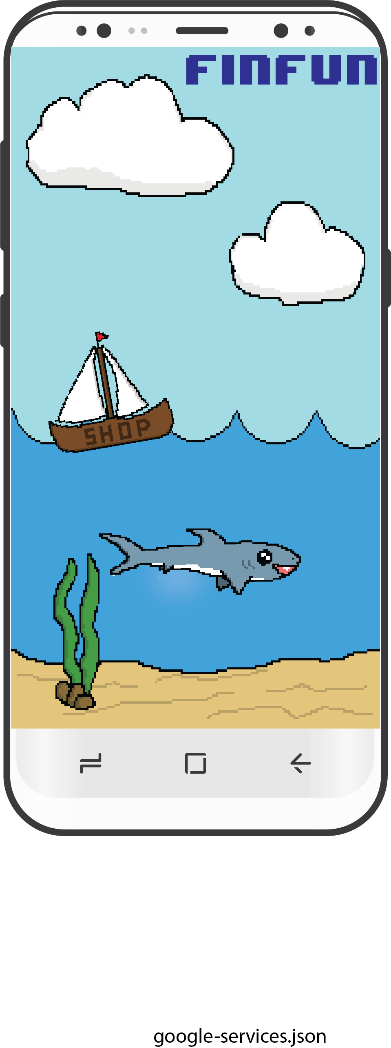
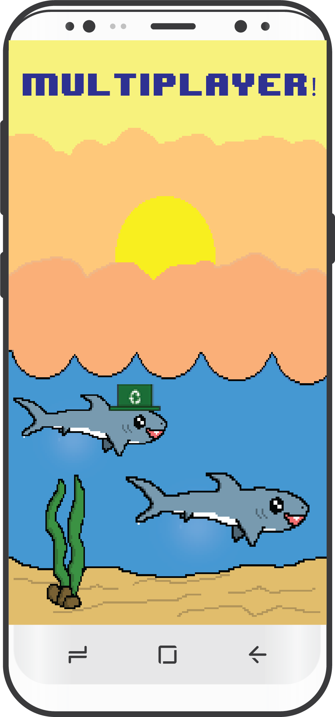
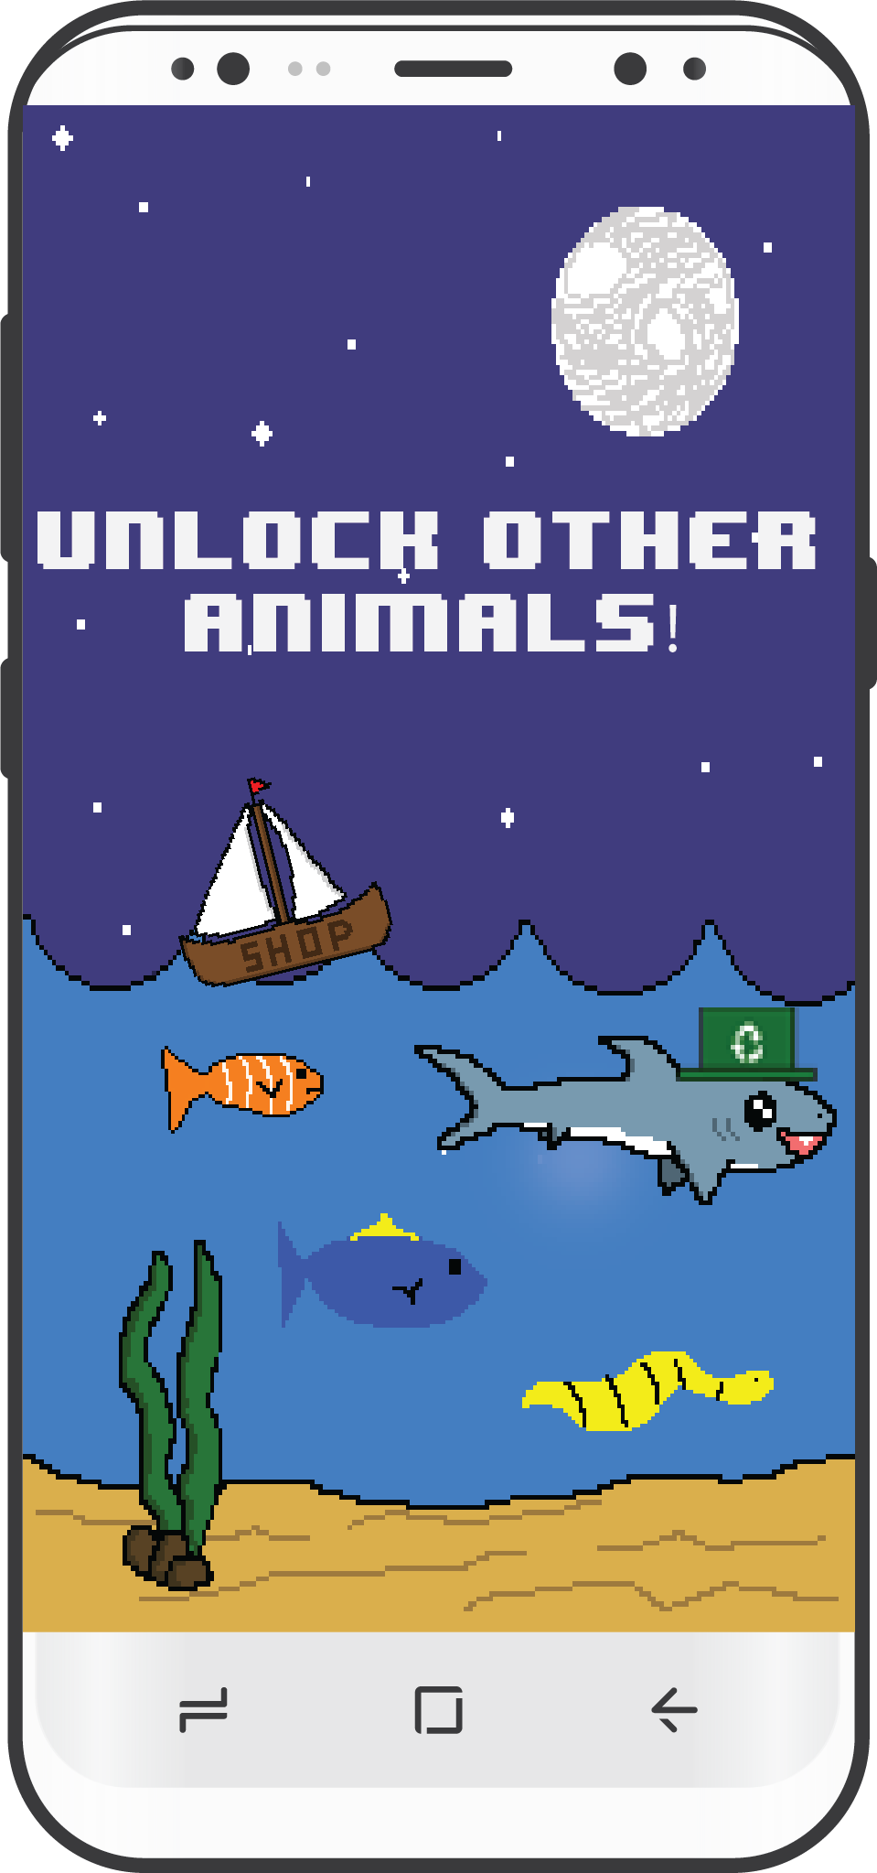
Future Capabilities

Slide 10
Acknowledgements
Thank you all for your support and guidance. Remember, small guppy actions, lead to big whale reactions

